Slide 1
Data Visualization
Final Project
Dafna Meron 311115349
10/01/22

Slide 2
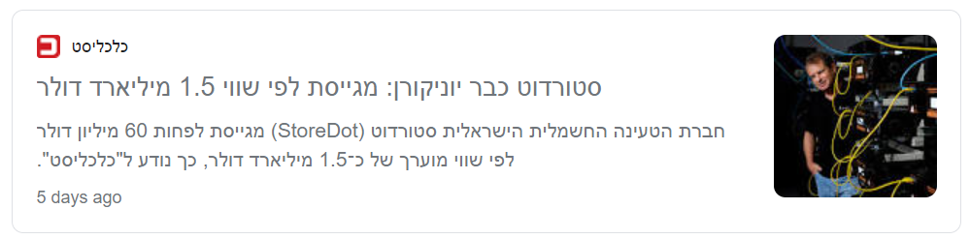


Slide 3

StoreDot is an Israeli startup company based in Herzliya.
The company develops extreme fast charged (XFC) Lithium-ion batteries based on materials innovation, design and synthesis of organic & inorganic compounds.
The company’s vision relates to the world of electrical vehicles (EV) that currently faces many challenges: low driving range, high battery cost, high battery weight, and mainly long recharging time - which can take several hours.
StoreDot’s innovative technology addresses all these issues and mainly aims to turn a 400 KM recharging experience into 5 minutes.
The development process focuses on finding new materials and configurations for a battery, which will provide the required performance according to the company's vision, with maximum safety, and minimum damage to natural resources.
StoreDot develops all the components that make a battery cell: Anode, Cathode & Electrolyte. The company also develops the entire system that eventually integrates all these components into a full battery pack with dozens of cells.

Slide 4
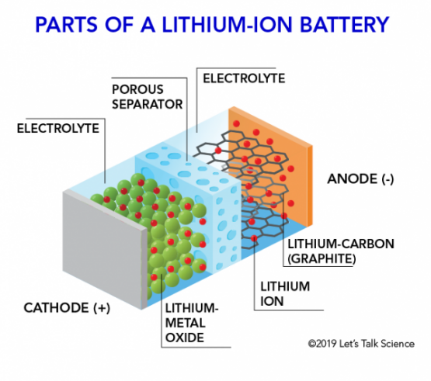
Short Explanation On Batteries
Lithium-ion battery is a type of rechargeable battery. Lithium ions move from the negative electrode (anode) through an electrolyte to the positive electrode (cathode) during discharge, and back when charging.

Slide 5
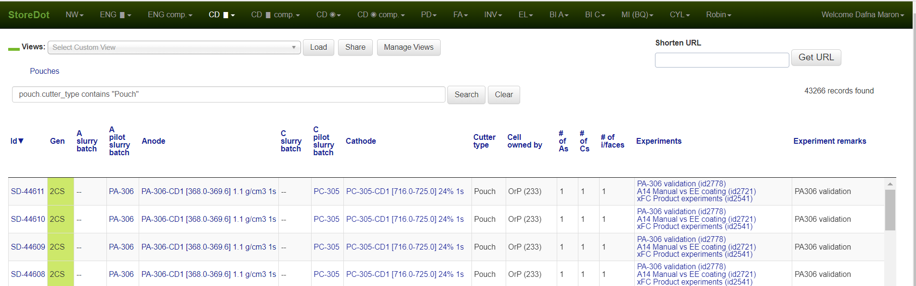
Data
For this project I used StorDot’s original database.
The main table is ‘Cells’ – each entity describes an experiment of a different battery cell configuration.
The first columns hold the experiment conditions – set parameters, and later the experiment results – measured parameters.
Other tables contain data on the materials of each cell component, product types, cell types, cell owners and more. This data source holds hundreds of thousands of entries dating back to 2017.

Slide 6
Data Preparation
For IP reasons, some of the data was changed, distorted and reduced.
All failed experiments were cleaned, data contained valid experiments only.
For most of the visualizations (except one) ‘currently running’ experiments were filtered, data contained ‘Finished’ experiments only.
Used SQL to query specific sub databases, products, experiments, groups and projects.
There are many complicated measured parameters in each experiment, for simplifying I focused on only few of them.

Slide 7
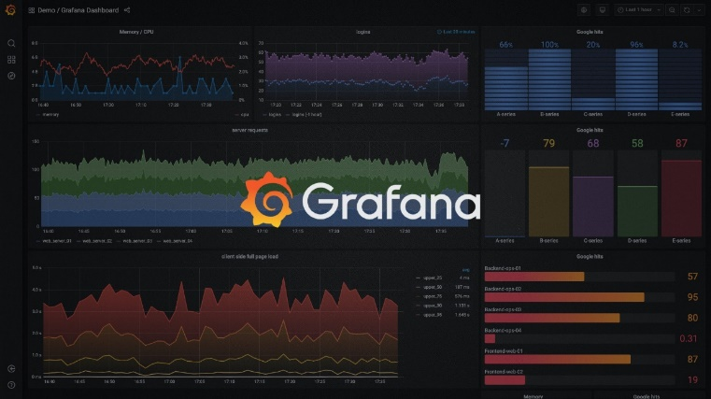
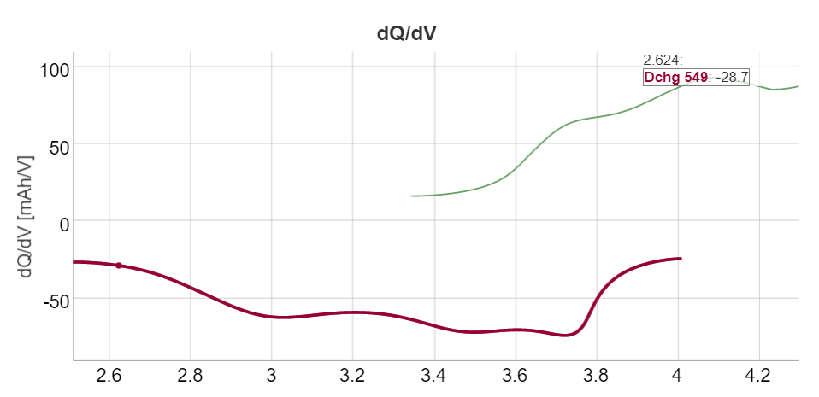
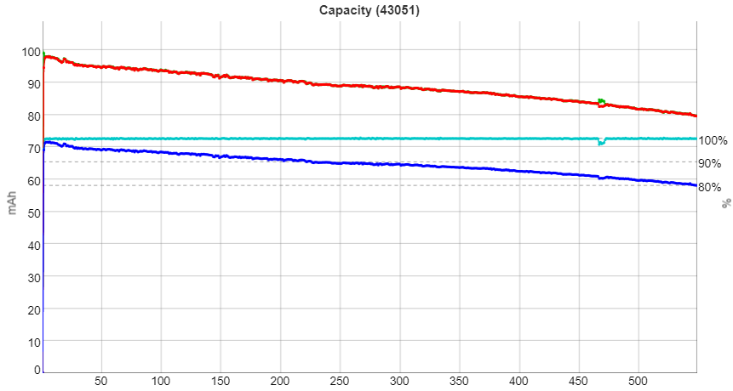
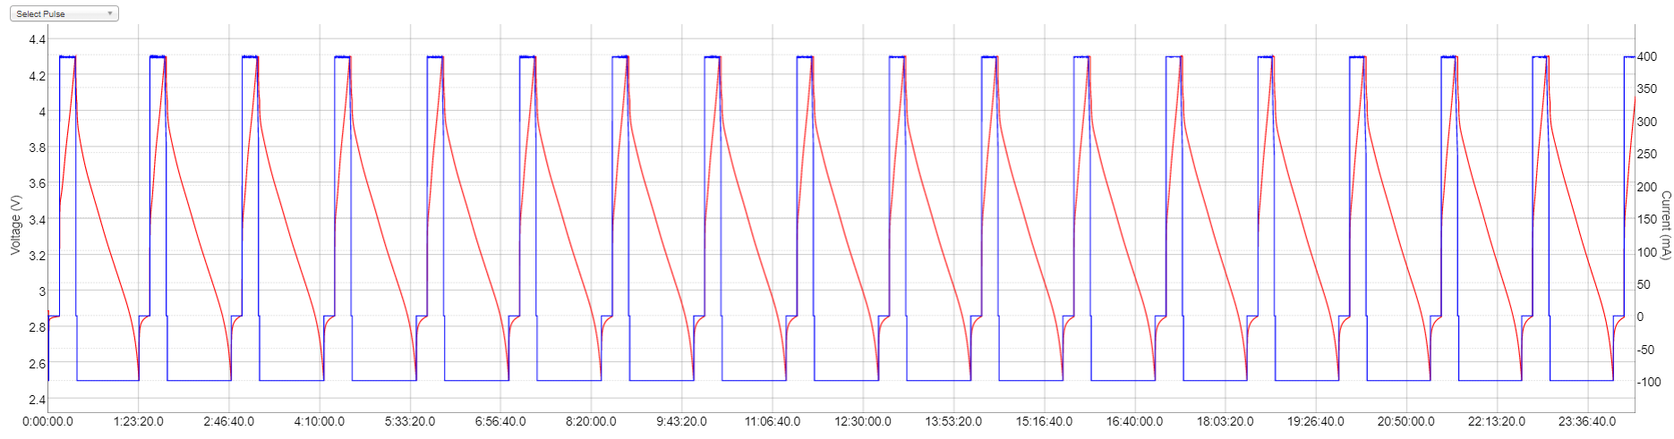
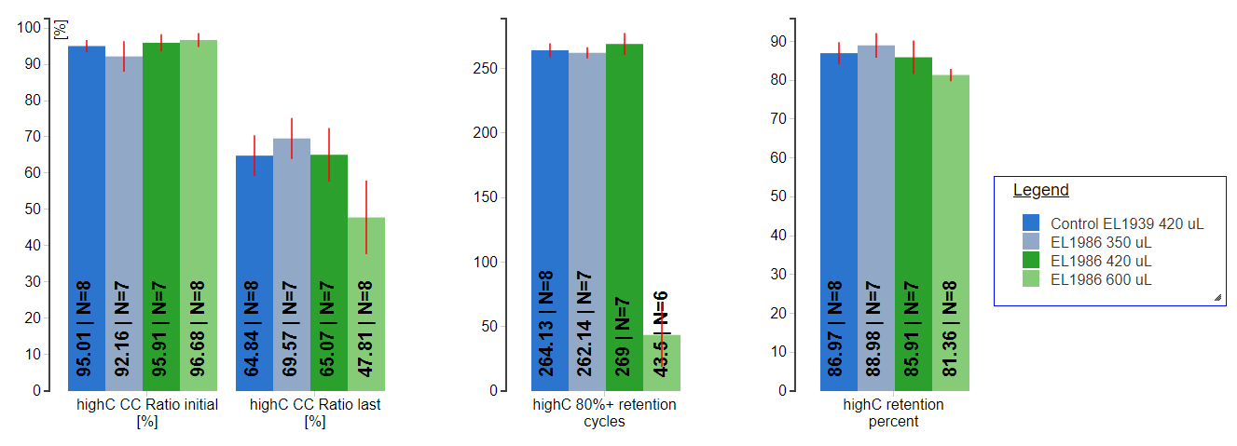
Data Visualizations In Use
Mainly single cell or single cycle visualizations
For aggregated data – internal simple tool for mostly bar charts
Recently started integration with Grafana

Slide 8


Language & Software

Slide 9

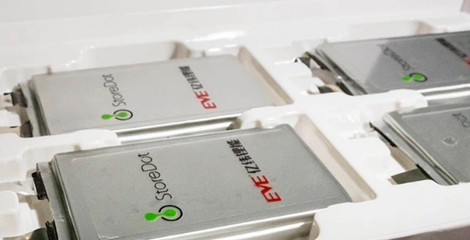
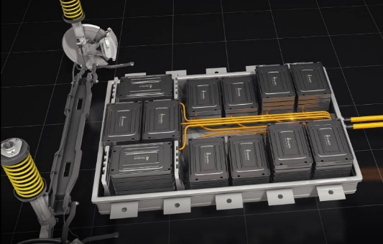
Visualization I - HeatMap
Coin
Pouch
What?
Two categorical key attributes: ‘Cell Type’ and ‘Researcher ID’
One quantitative value attribute: ‘Cell Count’
How?
Python - seaborn.heatmap() on pivot table
Why?
Learn and summarize the number & type of cells distribution for researchers in CD group. Identify outliers, knowing an expected trend.
Pack

Slide 10
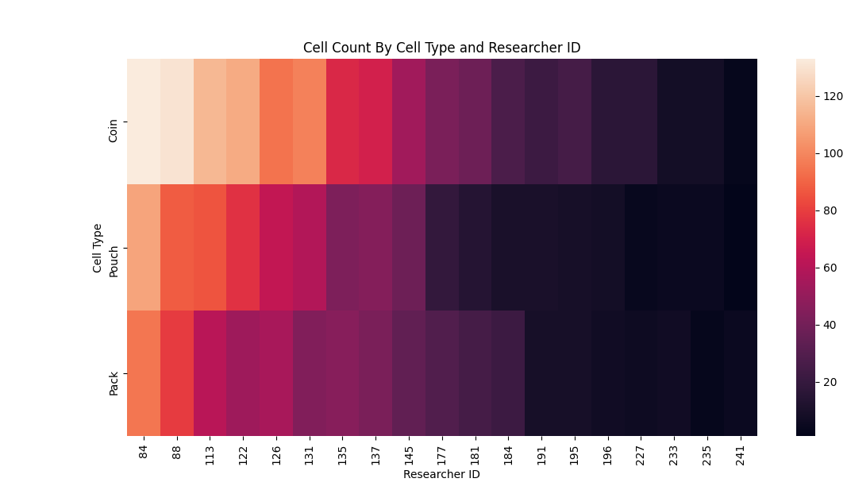

Slide 11
Visualization II – Stacked Area Chart
Coin
Pouch
What?
Quantitative value attribute: ‘Cell count’
Ordered key attribute: ‘Month in 2021’
Categorical key attribute: ‘Cell type’
How?
Tableau – area chart with ‘Months’ as dimension, ‘Cell Count’ as measurement and marked by ‘Cell Type’
Why?
Learn about changes in R&D cell production over the last year. How each cell type contributed to the total count and how it compares to others.
Pack

Slide 12
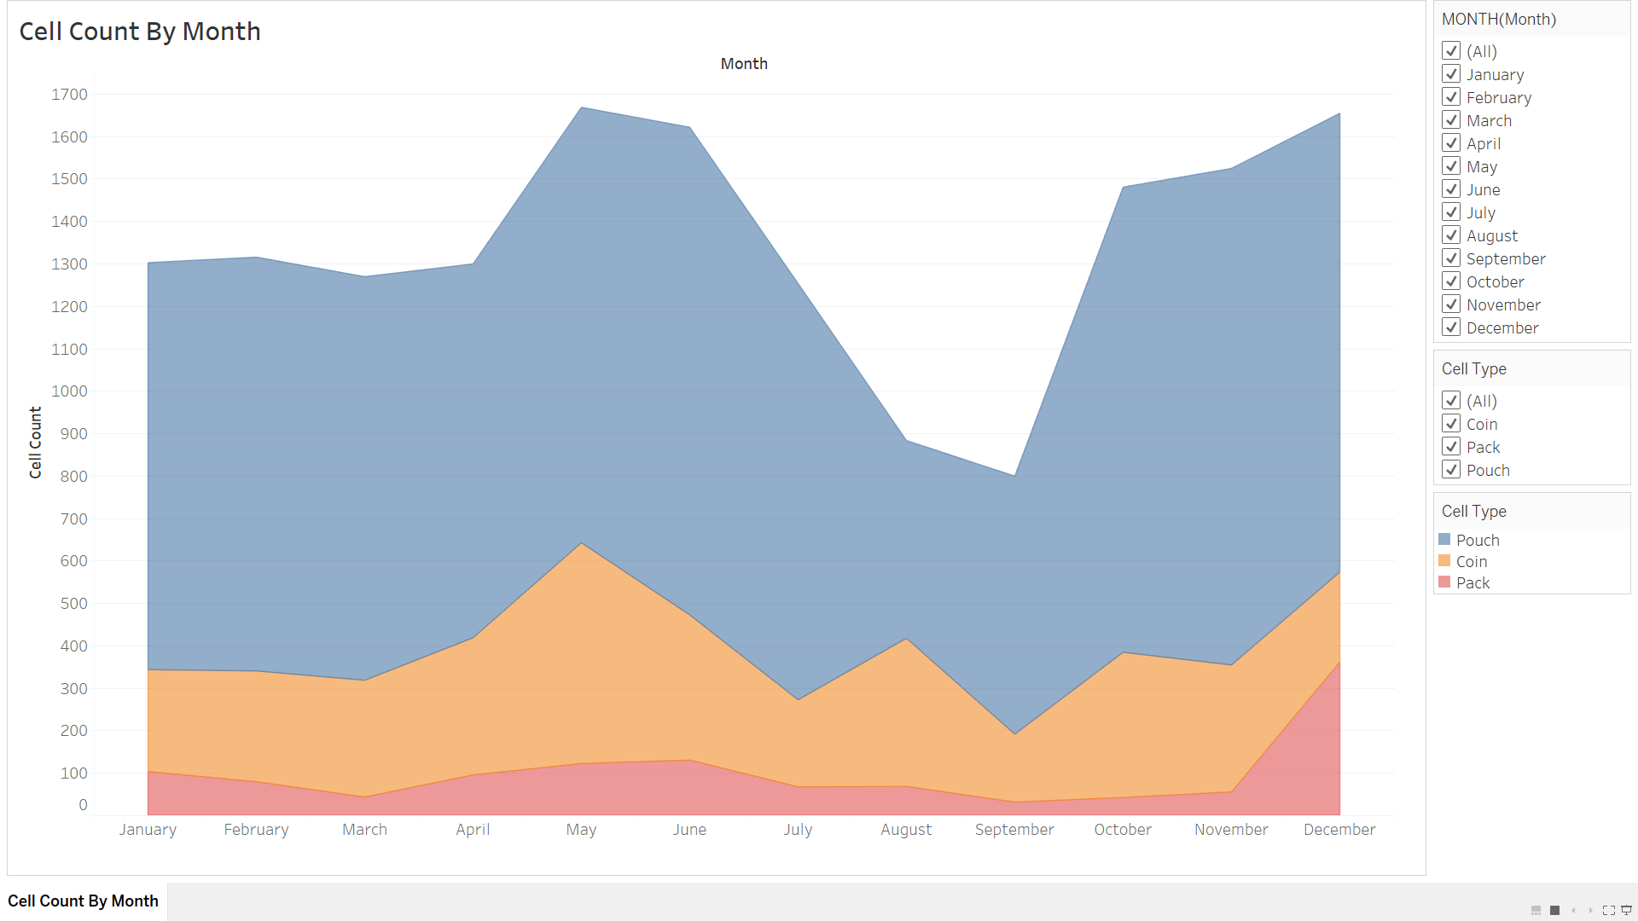
Visualization I

Slide 13
Visualization III – Density Curve
What?
Quantitative value attribute: ‘Cycle’
Categorical key attribute: ‘Project’
How?
Python - seaborn.displot(kind=‘kde’)
Why?
Learn about cycle count distribution of each project. Use smoothing to get general sense instead of noisy exact counts.
Product: Current baseline performance testing
Innovation: Future improvements to define new and improved baseline
Safety: Current baseline safety testing

Slide 14
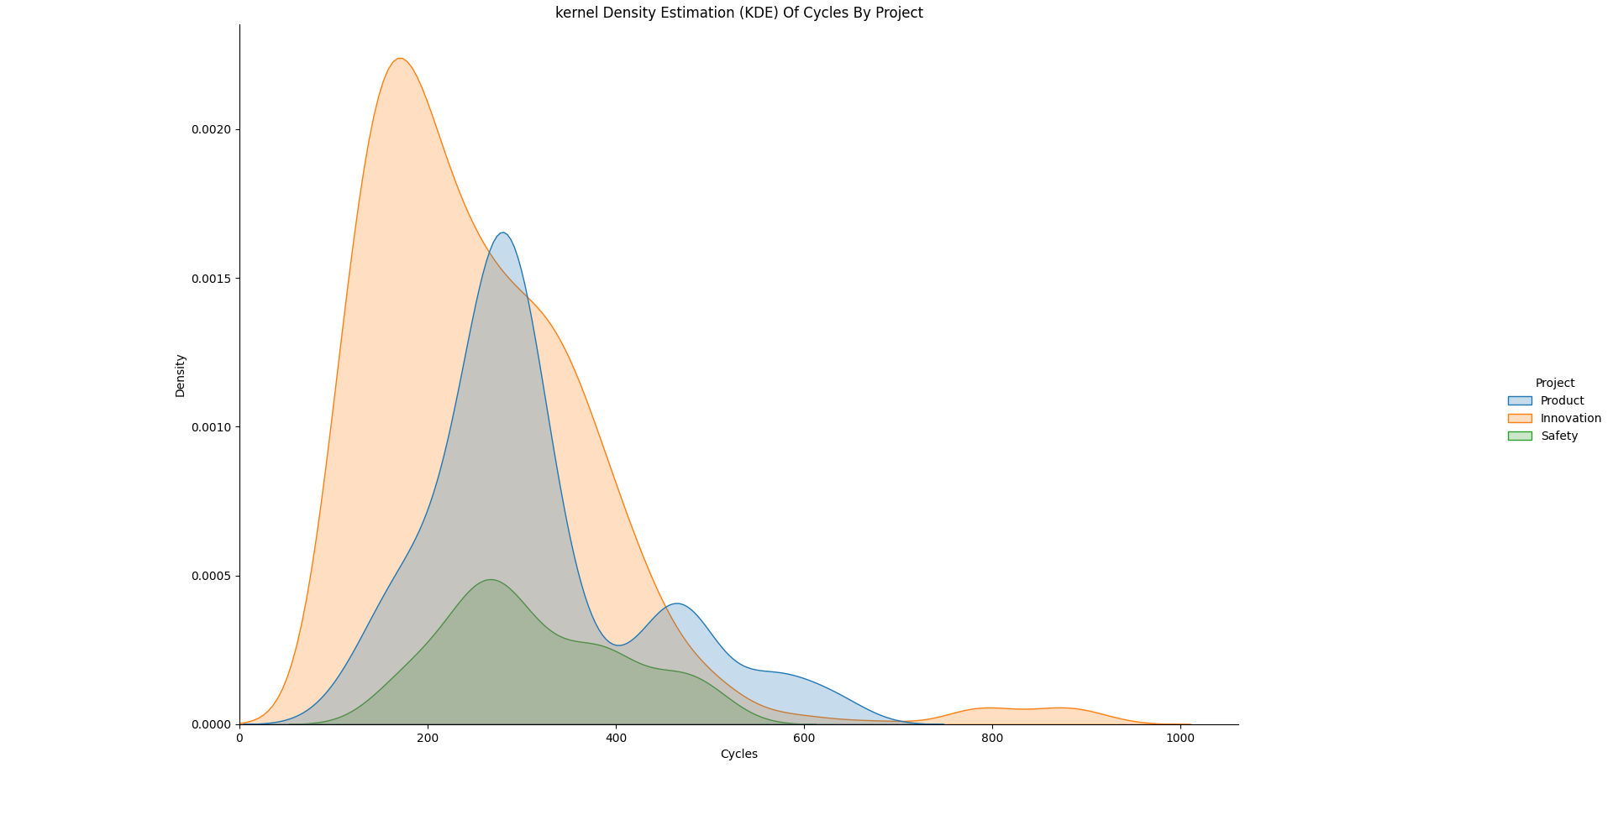

Slide 15
Visualization IV – Dot Chart
What?
Quantitative value attribute: ‘Cycle’
Quantitative value attribute: ‘Energy Density’
Ordered key attribute: ‘Week’
How?
Tableau – dot chart with ‘Week’, ‘AVG Energy Density’, ‘AVG Cycles’ as measurements and marked by ‘Generation’
Why?
Learn about StoreDot’s performance progress over time and the relationship between cycles and energy density.
1-Ge
2-Gr
2-CSi

Slide 16
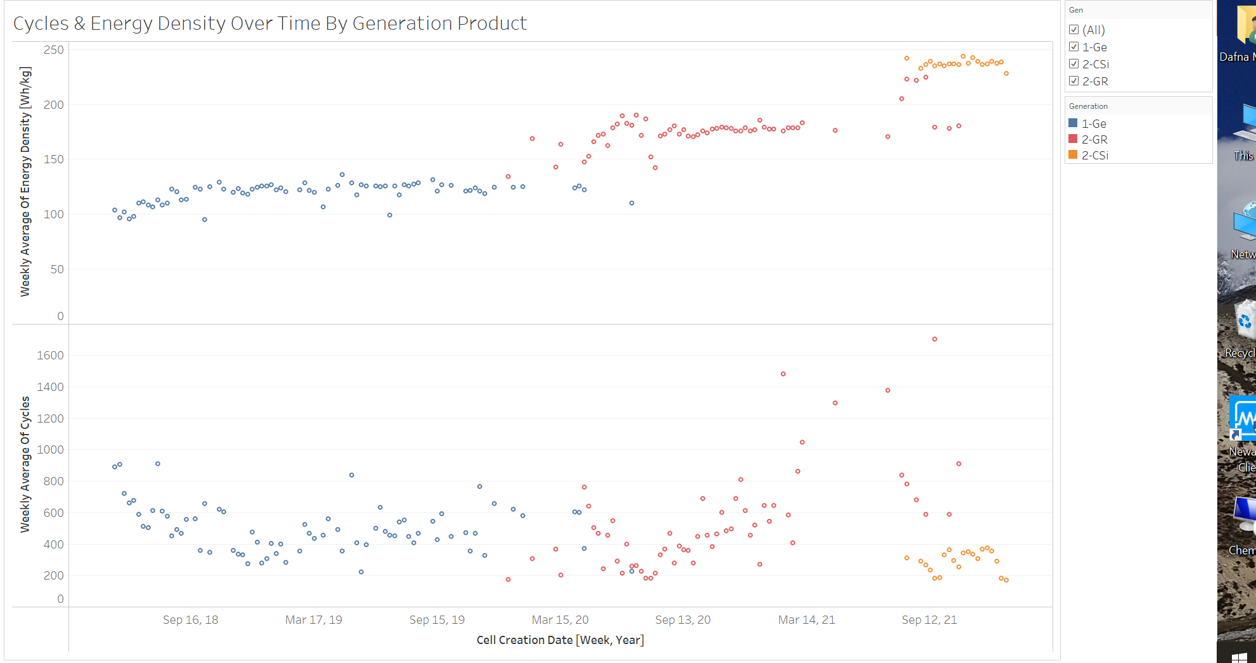

Slide 17
Visualization V – Scatter Plot Matrix
What?
Target Quantitative value attribute: ‘Energy Density
Quantitative value attributes: ’‘AVG CC/CV Ratio’, ‘Cycle 3 Discharge Voltage’ and ‘Average C.E’
How?
Tableau – scatter plot with ‘Energy Density’, ‘AVG CC/CV Ratio’, Cycle 3 Discharge Voltage’ and ‘Average C.E’ as measurements, marked by ‘Anode Batch ID’, ‘Cathode Batch ID’ and ‘Electrolyte Type’
Why?
Learn about correlative QC parameters to the cell actual energy density. Identify outliers and perform investigation.

Slide 18
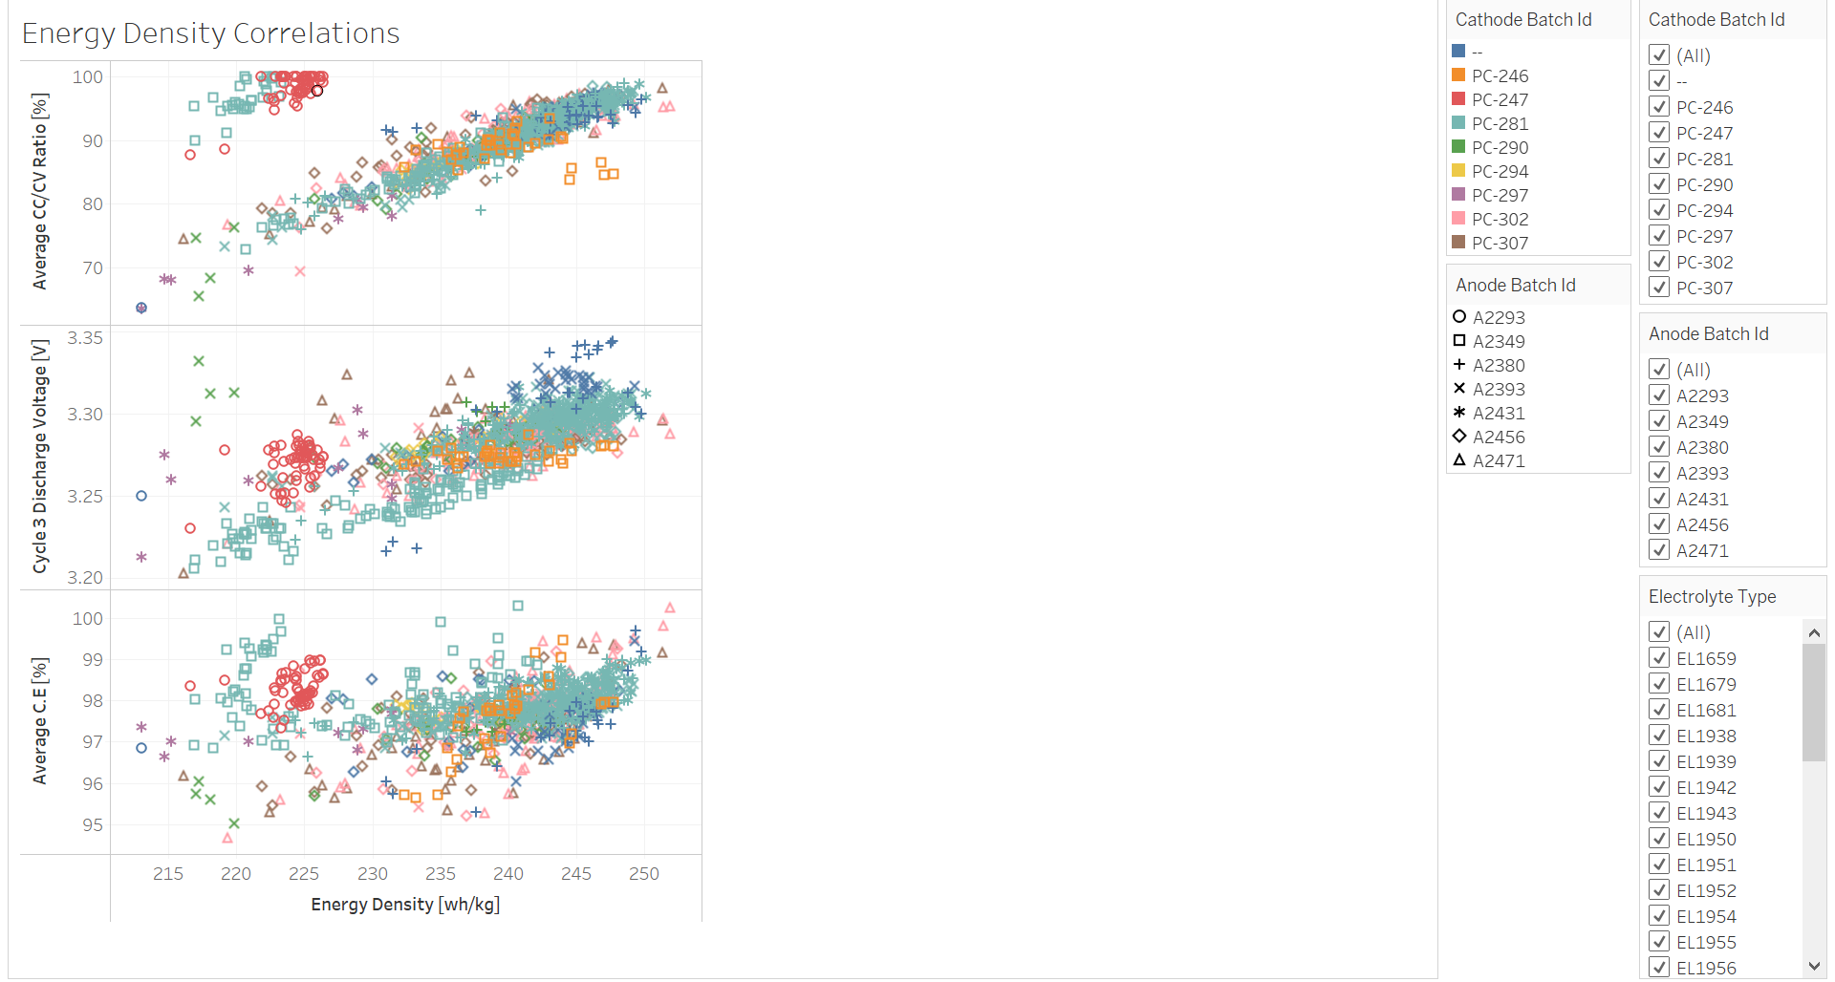

Slide 19
Visualization VI – Error Bar
What?
Quantitative value attribute: ‘Capacity Retention’
Quantitative value attribute: ‘Cycle’
Categorical key attribute: ‘Electrolyte Type’
How?
Python – Matplotlib.pyplot.errorbar()
Why?
Get an early indication on capacity degradation for ‘currently running’ experiments.
Learn about cells’ repeatability and the experiment progress.

Slide 20
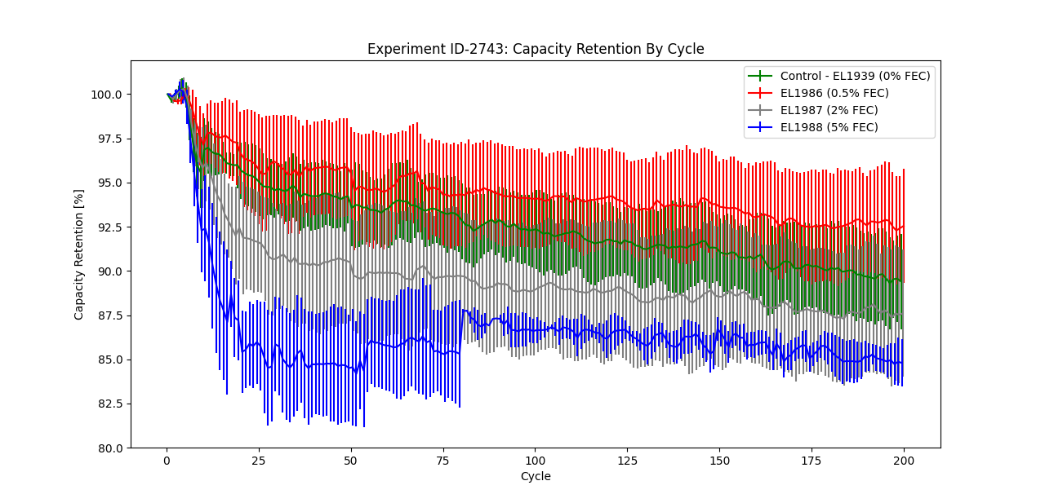
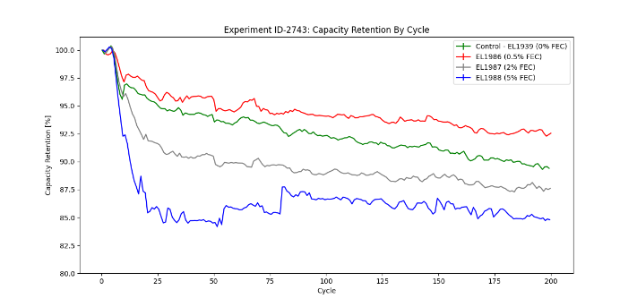
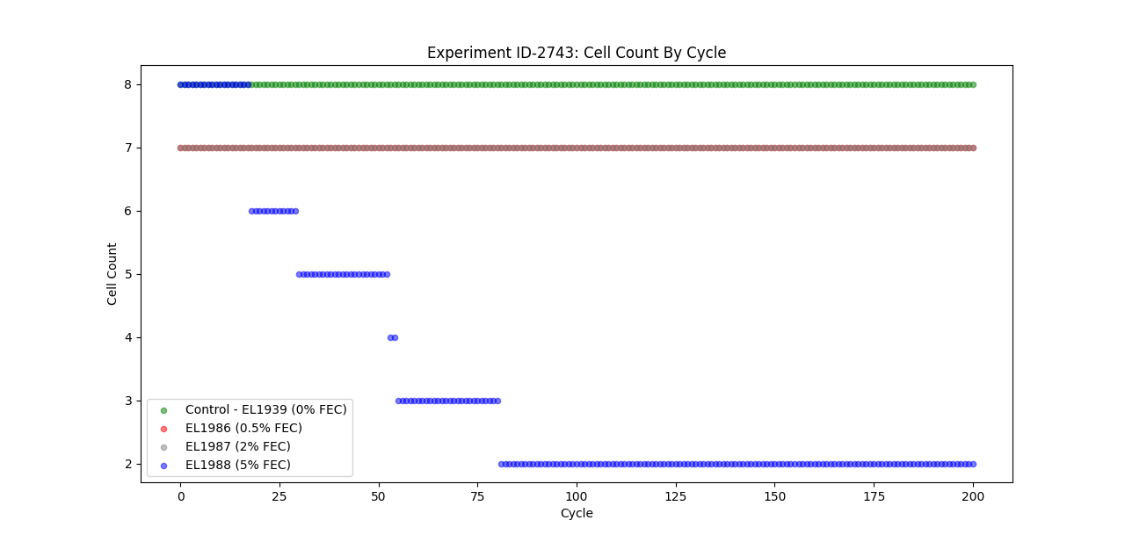

Slide 21
Thank You!

